Slide 1
System Analysis and Design

Slide 2
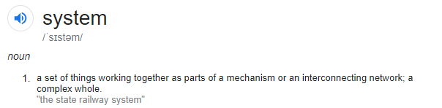

Slide 3
The word System is derived from Greek word Systema, which means an organized relationship between any set of components to achieve some common cause or objective.

Slide 4
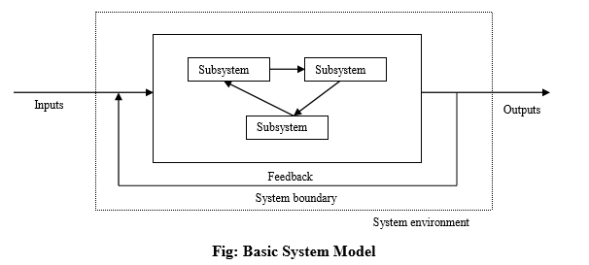

Slide 5
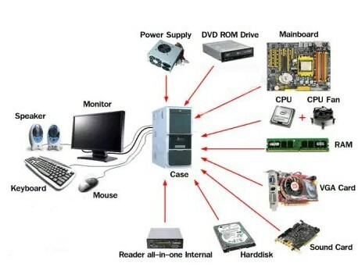

Slide 6
Systems Analysis
It is a process of collecting and interpreting facts, identifying the problems, and decomposition of a system into its components.
“what the system should do?”

Slide 7
Systems Design
process of planning a new business system or replacing an existing system by defining its components or modules to satisfy the specific requirements.
“how to accomplish the objective of the system?”

Slide 8
Characteristics of System
Organization
Interaction
Interdependence
Integration
Central Objective

Slide 9
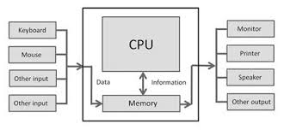
Organization
Structure and order
Arrangement of components to achieve goals

Slide 10
Interaction
“Functioning of one component (sub system) with other”

Slide 11
Interdependence
“How the components of a system depend on one another”

Slide 12
Integration
“How a system components are connected together”

Slide 13
Central Objective
Objective of system must be central

Slide 14
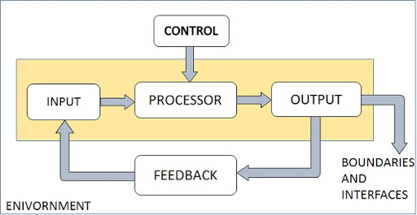
Elements of System

Slide 15
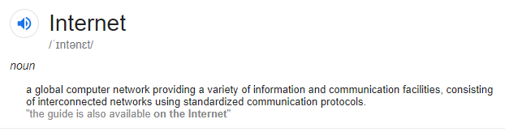

Slide 16
The Internet is the global system of interconnected computer networks that use the Internet protocol suite (TCP/IP) to link billions of devices worldwide.

Slide 17
Information System
Information system, an integrated set of components for collecting, storing, and processing data and for providing information, knowledge, and digital products.

Slide 18
Types of Information System
Transaction Processing System
Management Information System
Decision Support System
Executive Support System

Slide 19
Transaction processing system
A transaction processing system(TPS) is an information processing system for business transactions involving the collection, modification and retrieval of all transaction data.
A TPS records internal and external transactions for a company.
A TPS performs routine , repetitive tasks
Transactions can be recorded in batch mode or online.
There are six steps in processing a transaction. They are data entry, data validation, data processing and revalidation, storage–output generation and query support.

Slide 20
Process data generated by and about transactions
Maintain a high degree of accuracy and integrity
Avoid processing fraudulent transactions
Produce timely user responses and reports
Increase labor efficiency
Help improve customer service
Help build and maintain customer loyalty
Achieve competitive advantage

Slide 21
Management Information System
Designates a specific category of information systems serving middle management.
Provides middle managers with reports on organization’s current performance.
Information thus obtained is used to monitor and control and business and predict future.

Slide 22
MIS is an integrative system
MIS is Sub System concept
Provides relevant information to management
MIS is flexible
Enhances productivity
Is a coordinated system
Feedback system

Slide 23
Decision Support System
A decision support system (DSS) is a computer program application that analyzes business data and presents it so that users can make business decisions more easily.

Slide 24
Executive Support System
Executive Support System include expertise in order to aid managers in diagnosing problems or in problem-solving. These systems are based on the principles of artificial intelligence research.

Slide 25
Information Technology
Information technology is the study, design, development, implementation, support or management of computer-based information systems—particularly software applications and computer hardware.

Slide 26
Impact of IT
Flow of Information
Transaction processing
Decision Support
Workgroup support
Executive support
Data Management
Communication

Slide 27
POSITIVE IMPACT OF INTERNET ON BUSINESS
Improved communication
Easy marketing of products and services
Telecommuting
Better collaboration
Easy advertisement
Increase in research

Slide 28
NEGATIVE IMPACT
Poor impersonality
Increased unnecessary competition
Worrying security
Quick destruction of company reputation
Low confidence in the business

